Slide 1
Cultural Competency Training
Proprietary and Confidential

Slide 2
Objectives
Define Cultural Competence
Review Culturally and Linguistically Appropriate Services (CLAS) Standards
Review HFS Contract Requirements
Discuss 5 levels of Cultural Competence
Identify Barriers to Culturally Competent Care
  - List three barriers to health care experienced by the LGBT community
  - List two ways that LGBT related stressors may impact mental and physical health
  - Identify three LGBT culturally competent practices/ strategies
  - Identify transportation barriers
Review Impact of Healthcare Disparity
Americans with Disabilities Act of 1990 (42 U.S.C. § 12101)

Slide 3
What is Culture?
Integrated patterns of human behavior that includes thoughts, communications, actions, customs, beliefs, values, and institutions of racial, ethnic, religious, or social group.

Slide 4
Cultural Competence
We want to maintain a health care system and workforce that is capable of delivering the highest quality of care to every patient regardless of race, ethnicity, culture, or language proficiency.
We want the services we provide to respond to the unique needs of a member and be sensitive to the ways in which our members experience the world.
Cultural competence must be a guiding principle that ensures that services are culturally sensitive and provides appropriate prevention, outreach, assessment and intervention.

Slide 5
Cultural Competence
A set of consistent behaviors, attitudes, and policies that come together in a organization, agency, or among professionals that enables effective work in cross-cultural situations.
The ability to relate effectively to individuals from various groups and backgrounds.

Slide 6
5 Levels of Cultural Competence
Level 1 – No insight about the influence of culture on health care
Level 2 – Minimal emphasis on culture in the health setting
Level 3 – Acceptance of the role of cultural beliefs, values, and behaviors on health / wellness and treatment
Level 4 – Incorporation of cultural awareness into daily health practice
Level 5 – Integration of attention to culture into all areas of professional life associated with level 3. Acceptance of the role of beliefs, values, and behaviors on illness and treatment. Our certain knowledge, attitudes and skills.

Slide 7
LGBT Community
What do the letters in LGBT stand for?
Term | Lesbian | Gay | Bisexual | Transgender
Definition | Female same-sex attraction, sexual behavior | Used by both men and women to describe their sexuality | Attractions, behaviors directed at both sexes | One whose gender identity or gender expression differ from their birth sex

Slide 8
Gender Terminology
Term | Gender | Gender Identity | Gender Expression
Definition | A person’s biological sex Culture may ascribe certain feelings, behavior and attitudes | One’s sense of being a man, woman, or other gender | How a person expresses their gender Via appearance, personality, behavior

Slide 9
LGBT Assumptions & Barriers
Some assumptions about a member’s sexual orientation or gender identity can interfere with the trust and rapport.
Assumptions may also lead to a lack of competent care.
Stigma and Mistreatment may lead to:
Insensitivity to needs
Refusal of care
Inadequate or substandard care

Slide 10
Barriers may lead to…
Low comfort in utilizing health care services
Low trust in providers
Difficulty in discussing health concerns or needs
Lack of awareness and low competency
Due to lack of awareness the LGBT community is often overlooked in hospital and provider care education

Slide 11
Impact of Stressors
LGBT discrimination/ violence can lead to physical issues such as:
Sleep difficulties
Headaches
Digestive problems
Substance use
Agitation/ Tension

Slide 12
LGBT Strategies
Create a Welcoming Environment:
  Prominently post the facility’s nondiscrimination policy or patient bill of rights
  Show common areas reflecting/being inclusive of LGBT community
  Be mindful of visitation polices/ How requirements may affect the LGBT population
  Determine mechanisms for handling patient-to-patient discrimination

Slide 13
Diversity
What does it mean to serve a diverse population?
Why does diversity matter?
Why is diversity relevant to Cultural Competency?

Slide 14
What is Diversity?
Encompasses unique beliefs, values, and customs. Refers to people with many different cultures living and working around each other.

Slide 15
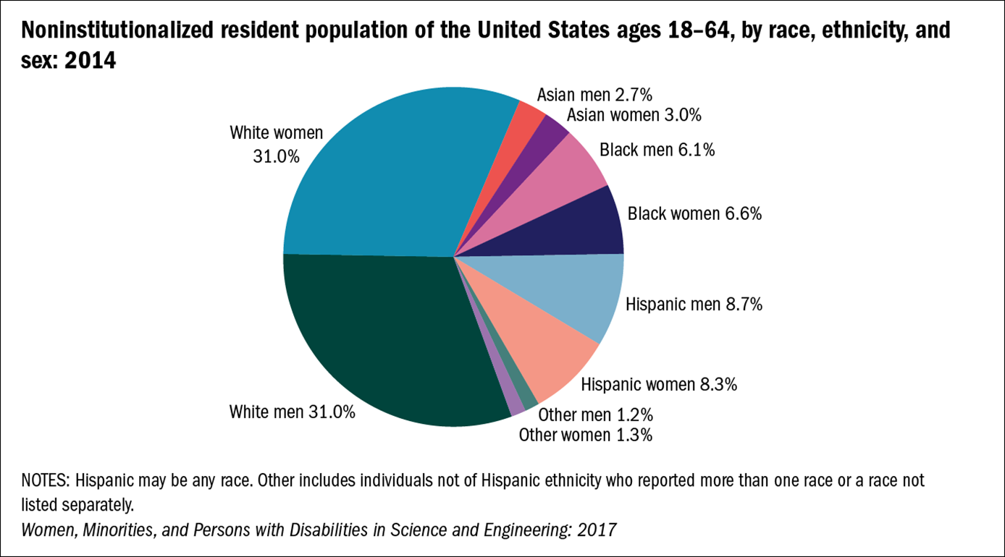


Slide 16
Test Your Knowledge
1. When doing cross-cultural work it’s most important to:
  Understand Asian and Latino family dynamics
  Understand racial identity issues
  Understand the psychodynamics of racism and prejudice
  Develop a working knowledge of our own worldview including the biases we bring to our work with others

Slide 17
Test Your Knowledge
2. Understanding our world view is important because:
        It allows us to be authentic in our relationship with our members and their families
        We should have an answer prepared if a member asks us about our culture
        When we work with members, we are working from our world view
        It makes us a more interesting person

Slide 18
Transportation
MeridianHealth provides two different types of medical transportation for our members. The type transportation used depends on whether the member needs emergency (EMT) or non-emergency medical transportation (NEMT) services.
Emergency Transportation (EMT)
An emergency is any event that puts the health and life of a Medicaid beneficiary at serious risk without immediate treatment. Medicaid reimburses emergency transportation providers when they furnish services to eligible beneficiaries according to the rules.
This is used for transporting patients in an emergency and are fully equipped with life-saving equipment and other medical supplies that are equipped for a safe and speedy trip to the nearest hospital.
Non-emergency Medical Transportation (NEMT)
Non-emergency medical transportation (NEMT) is an important benefit for Medicaid member who need to get to and from medical services but have no means of transportation.
The Code of Federal Regulations (CFR) requires States to ensure that eligible, qualified Medicaid beneficiaries have NEMT to take them to and from providers.
This is used for trips that are non-emergency in nature, meaning there is no immediate threat to the health or life of the participant. Members may require NEMT due to lack of a valid driver’s license, lack of a working vehicle, geographic isolation, or the inability to take traditional transportation for physical, mental, or developmental reasons.

Slide 19
Transportation Barriers
Currently, 3.6 million individuals do not access medical care because they experience transportation barriers.
Transportation barriers lead to rescheduled or missed appointments, delayed access to care, and missed or delayed medications use.
Common transportation barriers include long travel distances, lack of vehicle, transportation cost, inadequate infrastructure, and adverse policies affecting travel.
Meridian Complete is committed to address transportation barriers and building partnerships to improve transportation and health care access for patients and families and create more equitable, healthier communities.

Slide 20
Who is MeridianHealth’s vendor for (NEMT)?
Currently, 3.6 million individuals do not access medical care because they experience transportation barriers.
Transportation barriers lead to rescheduled or missed appointments, delayed access to care, and missed or delayed medications use.
Common transportation barriers include long travel distances, lack of vehicle, transportation cost, inadequate infrastructure, and adverse policies affecting travel.
MeridianHealth is committed to address transportation barriers and building partnerships to improve transportation and health care access for patients and families and create more equitable, healthier communities.

Slide 21
Ethnic Disparities in Health Care
African American women are more likely than European American women to die from breast cancer, despite having a lower incidence of the disease.
Infant mortality rates are 2.5 times greater for African Americans and 1.5 times greater for Native Americans than for European Americans.
Influenza death rates are higher for African Americans and American Indian/Alaska Natives/Native Alaskans than they are for European Americans.
Mortality for colorectal cancer is highest for African Americans, followed by Native Alaskans, and then Hawaiians.

Slide 22
The Surgeon General’s Report Mental Health:
Culture, Race and Ethnicity
Members of racial and ethnic minority populations:
  Are less likely to receive necessary mental health care;
  Often receive a poorer quality of treatment;
  Are significantly underrepresented in mental health research.
  Are less likely to have access to available mental health services;
  Underuse mental health services and are more likely to delay seeking treatment.
Consequently, in most cases, when such individuals seek mental health services they are at an acute stage of illness. This delay can result in a worsening of untreated illness and an increase in involuntary services.

Slide 23
Contributing Factors to Health Disparities
Fear of being misunderstood or disrespected
Providers are not familiar with the prevalence of conditions among certain minority groups
Providers may fail to take into account differing responses to medication
Providers may lack knowledge about traditional remedies, leading to harmful drug interactions
Patients may not adhere to medical advice because they do not understand or do not trust the provider
Providers may order more or fewer diagnostic tests for patients of different cultural backgrounds

Slide 24
What Is Your Role?
Think about your role at Meridian Complete.
How do you apply what you learned / discussed in this training to your everyday operations?
What is the culture of your office/working environment?

Slide 25
Positive Impacts of Cultural Competency
More successful patient education
Increases in patient’s health care seeking behavior
More appropriate testing and screening
Fewer diagnostic errors
Avoidance of drug complications
Greater adherence to medical advice
Expanded choices and access to high-quality clinicians

Slide 26
What is the Americans with Disabilities Act (ADA)?
The Americans with Disabilities Act (ADA) became law in 1990. The ADA is a civil rights law that prohibits discrimination against individuals with disabilities in all areas of public life, including jobs, schools, transportation, and all public and private places that are open to the general public. The purpose of the law is to make sure that people with disabilities have the same rights and opportunities as everyone else. The ADA gives civil rights protections to individuals with disabilities similar to those provided to individuals on the basis of race, color, sex, national origin, age, and religion. It guarantees equal opportunity for individuals with disabilities in public accommodations, employment, transportation, state and local government services, and telecommunications. The ADA is divided into five titles (or sections) that relate to different areas of public life

Slide 27
Examples of conditions that are impairments
AIDS, and its symptoms
Alcoholism
Asthma
Blindness or other visual impairments
Cancer
Cerebral palsy
Depression
Diabetes
Epilepsy
Hearing or speech impairments
Heart Disease
Migraine Headaches
Multiple sclerosis
Muscular dystrophy
Orthopedic impairments
Paralysis
Complications from Pregnancy
Thyroid gland disorders
Tuberculosis
Loss of body parts
Certain temporary, non-chronic impairments of short duration with little or no residual effects usually are not disabilities. Likewise, environmental conditions and alternative lifestyles are not protected. A person currently engaging in the illegal use of drugs is not considered an individual with a disability. This refers both to the illegal use of unlawful drugs such as cocaine as well as prescription drugs.

Slide 28
What is BEP? Our Policy tied to Purpose
Business Enterprise Program
  Act for Minorities, Females and Persons with Disabilities (BEP) –
  The State law, 30 ILCS 575, that establishes a goal for contracting with businesses that have been certified as owned and controlled by individuals who are minority, female or who have disabilities.
BEP Policy IL.OPS.31
Our Purpose
  “Transform the health of the community one member at a time”
  The community includes businesses that are part of the BEP program. Engaging these community partners therefore aligns to our purpose. These businesses can help build the economic vitality of the community by creating jobs, building the tax base, and carrying a positive brand message to the community when they are aligned and believe in a corporation’s commitment. On the other hand when these businesses do not, they can create an unfavorable brand image for organizations with state contracts and BEP goals.

Slide 29
Roles and Responsibilities At-A-Glance
Business Owner (BO)
Sr. Director of BEP
Finance
Vendor Management
Determine business need and verify BEP certification in the BEP Directory
Obtain Request for Proposal (RFP) from the Vendor
Submit RFP to Sr. Director of BEP for approval
Obtain completed signed Letter of Intent (LOI), Business Associates Agreement (BAA), Non Disclosure Agreement (NDA), and State of Work (SOW) in collaboration with Vendor Management
Work with vendor, Finance and Sr. Director of BEP to finalize vendor agreement and LOI %/ $ Amount
Write business justification
Document Good Faith Efforts
Ongoing day-to-day relationship oversight
Work with Vendor Management and Plan Leadership for RFP approval
Monitor overall utilization and identify areas of opportunity
Monitor spend in collaboration with Finance
Monitor Good Faith Efforts Log and report to Plan Leadership
Identify risk areas and report immediately to Plan Leadership
Assist Business Owner and vendor with renewing BEP certification if vendor certification has expired
Determine % or payment amount the vendor will contribute to the BEP utilization plan
Develop and monitor monthly and quarterly reports
Submit BEP reports to Sr. Director of BEP
Monitor BEP vendor certification status and exclude above reporting as appropriate
Assist Business Owner, Sr. Director of BEP, dept. leads with contracting process
Assist Business Owner with completing a Letter of Intent
Compliance
  Submit LOI, Vendor Agreement, and written justification to State BEP Liaison for approval of new vendors
  Monitor Compliance with BEP Contract requirements Monthly, Quarterly and Annually and submit quarterly reports to the State BEP Liaison

Slide 30
Plan Contact and Resources
Department | Contact | Phone/Email
Director, Compliance | Katie M. Barbera | Katherine.Lustig@mhplan.com
Senior Compliance Analyst | Matthew L. Purcell | Matthew.L.Purcell@centene.com
Director, Vendor Management | Eric J. Johns | Eric.Johns@mhplan.com
Vendor Management Analyst | Michael Ruppert | Michael.Rupperr@centene.com

Slide 31
Plan Contact and Resources
Resources | Location/Folder
Letter of Intent Template | \\centene.com\shared\WMT\Compliance\Business Enterprise Program (BEP)\LOI Template
BEP Utilization Plan | \\centene.com\shared\WMT\Compliance\Business Enterprise Program (BEP)\BEP Utilization Plan
BEP Quarterly Reports | \\centene.com\shared\WMT\Compliance\Required Compliance Reporting
BEP Monthly Reports | \\centene.com\shared\WMT\Compliance\Business Enterprise Program (BEP)\BEP Monthly Reports
Good Faith Efforts Log | \\centene.com\shared\WMT\Compliance\Business Enterprise Program (BEP)\Good Faith Efforts Tracking Log

Slide 32
References
hhttp://www.esri.com/news/arcnews/winter1112articles/major-trend-revealed-in-census-2010-data.html
http://agilitrix.com/2011/03/how-to-make-your- culture-work/
Adapted from Centene’s Cultural Awareness in Health Care, 2010
National Association of State Mental Health Program Directors at http://www.nasmhpd.org
Mental Health and Indian Clients by Laetitia Puthenpadath and Philip Culbertson at http:///www.gmd.net.nz/index.lasso?view=27
Adapted from Relias Learning “A Culture-Centered Approach to recovery“
Americans with Disabilities Act of 1990 (42 U.S.C. § 12101)
http://www.logisticare.com/about/ https://www.ncqa.org/hedis/reports-and research

Slide 33
Resources
https://www.kff.org/medicaid/state-indicator/non-emergency-medical-transportation-services/?currentTimeframe=0&sortModel=%7B%22colId%22:%22Location%22,%22sort%22:%22asc%22%7D

Slide 34

Questions

